Slide 1
Hello and welcome to
Our Future Heroes Social Care session, we will begin shortly.
Please mute your mics and switch off your cameras.
If you need technical assistance please use the chat box and we will be happy to help.

Slide 2
House Keeping
Please mute your microphone and turn off your cameras. This will help us manage background noise during the presentations.
Please do not take any recordings or screen shots of the screen during the session
If you need any technical help during the event please message us using the chat box.
If you would like to ask a question please use the chat box.
The session will be not be recorded live but we will be uploading the presentations to the Extra Heroes webpage after this session.
Please bear with us if there are technical issues we will resolve them as quickly as possible. You may find that some of the videos we play may buffer, we will share the links after the event for anyone who had any issues watching them.
Social media – please tag us in @hwe_academy and #Future Heroes
Please join in with the quizzes and activities
Your feedback is important to use please feel free to email us – academy.hwe@nhs.net

Slide 3
Social Care
An informative session discussing the many roles within social care

Slide 4
Introductions
Sannah Ayoub, Adult Care Services, Hertfordshire County Council
Rebecca Green, Herts Good Care, Hertfordshire Care Providers Association
Nicole Johnson, Herts Good Care, Hertfordshire Care Providers Association

Slide 5
Quiz
How many people over the age of 65 are living with dementia in the UK?
What is the main difference between a nursing home and a care home?
Why do you need to be person-centred when providing care and support?

Slide 6
What is adult social care?
Adult social care is the support provided to vulnerable adults who cannot carry out day to day activities by themselves.
This could be for personal care such as eating, washing or getting dressed, or for domestic routines such as cleaning or going to the shops.
Each person who receives care or support will be provided with person-centred care meaning the care is delivered in a way that suits them and their individual needs
The goal is to maintain and promote the independence and well-being of a vulnerable adult
Notes:
Rebecca to talk through each point very briefly and advise that it’s to support anyone who is vulnerable and needs a bit of extra help to be able to do all the things you and I may do that we don’t

Slide 7
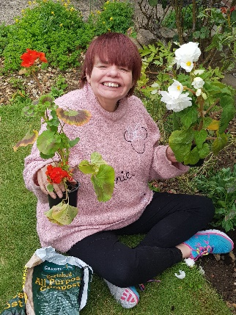
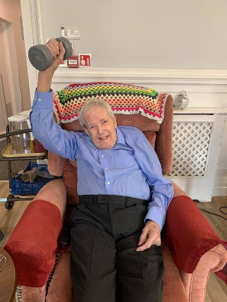
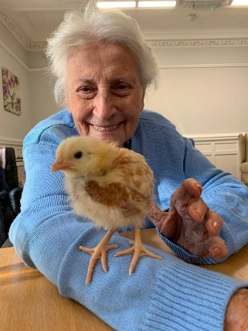
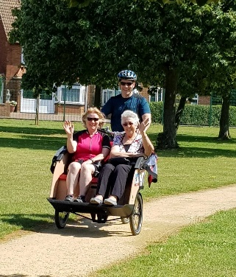
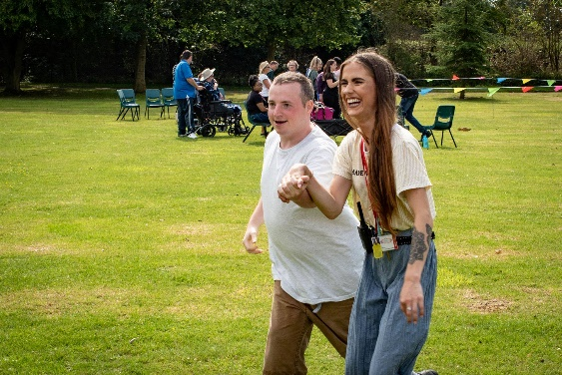
Who needs my care and support?
Older people
People living with dementia
Individuals who have learning disabilities
Those receiving end of life (palliative) care
Physical disabilities
Mental health conditions
Sensory impairment
Notes:
Nicole. Did you know that 1 in 14 people over the age of 65 are living with dementia?

Slide 8
What type of setting could I work in?
Care Home
Nursing Home
Supported Living
Live-In Care
Flexicare
Respite Care
Day Services
Domiciliary (Support at Home)
Notes:
Rebecca to talk about Care Home, Nursing Home (main difference is some residents will have clinical needs and so RN’s work there too to provide this care)
Nicole to talk about Day Service and Supported Living (day services great for tackling loneliness in local communities). Supported Living (explain how it’s like a house or a block of flats and it’s more independent than a care home)
Rebecca talk about Live-In Care
Nicole to talk about Flexicare and Respite Care
Rebecca to talk about Domiciliary

Slide 9
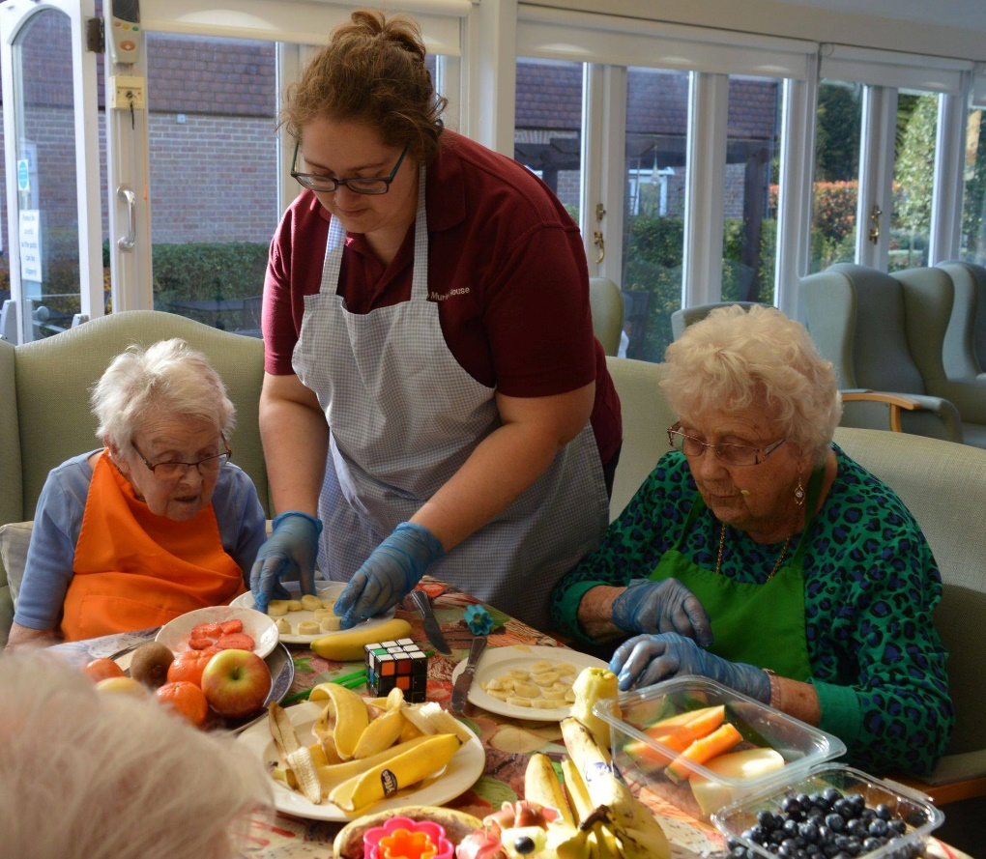
What jobs are available in adult social care?
Care Assistant
Support Worker
Activities Coordinator
Kitchen
Housekeeping
Maintenance
Business Support
Clinical roles
Management
Training
Notes:
Nicole to cover

Slide 10
What career progression is available?
Get your level 2 and then level 3 in Health and Social Care. There are level 5, 4 and Degree apprenticeships available too
Complete other courses in specific areas like dementia or engagement or exercise
Become a Senior or Key Worker
Move into training and quality control
Take the clinical route and study nursing, social work or occupational therapy
Complete management qualifications and make your way up
Notes:
Nicole

Slide 11
What do I need to get into care?
Values and Beliefs | Transferrable Skills
A flexible approach | Creativity
Person-centred care | Patience
Make a difference | Observant
A caring attitude | Empathetic
Honesty and Integrity | Good listener
Willingness to learn | Customer service
Open-mindedness | Team Player
Notes:
Rebecca to go through and emphasise we can teach the skills and the main thing is. For person centered please explain the quiz answer that there is no one way suits all in care and the individual needs and how they want care provided comes first.

Slide 12
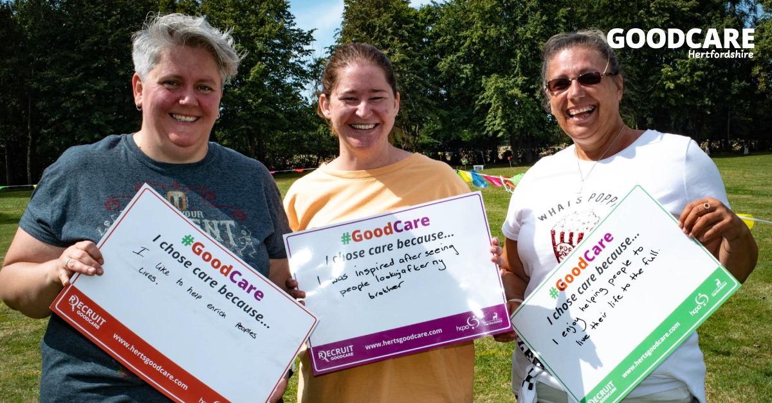
Why should I choose adult social care?
It’s rewarding
Every day is different
Job security
Career progression
Development and Qualifications
Flexible and varied
Further education opportunities
Notes:
Nicole to do quick over view

Slide 13
How do I start my career in care?
Visit www.hertsgoodcare.com to register interest in an apprenticeship, work experience or a job
Follow us on Facebook, Twitter and Instagram to learn more @hertsgoodcare
Work Experience
Apprenticeships
Traineeships
Full time and Part time jobs while you study at college or sixth form
Notes:
Nicole to go through then Rebecca say what she does

Slide 14
Quiz Answers
How many people over the age of 65 are living with dementia in the UK?
1 in 14 individuals
What is the main difference between a nursing home and a care home?
A nursing Home supports individuals with clinical needs too and will have Registered nurses working there to provide this care
Why do you need to be person-centred when providing care and support?
Each individual will have different needs and preference, it is not ‘one way suits all’ when it comes to care

Slide 15
What do social workers do ?
Sannah Ayoub, Adult Care Services, Hertfordshire County Council

Slide 16
Social workers work with a number of people at any one time. This is often referred to as a caseload. Day-to-day work involves assessing people’s needs, strengths and wishes, working with individuals and families directly to help them make changes and solve problems, organising support, making recommendations or referrals to other services and agencies, and keeping detailed records.
The problems social workers deal with are often rooted in social or emotional disadvantage, discrimination, poverty or trauma. Social workers recognise the bigger picture affecting people’s lives and work for a more equal and just society where human rights are respected and protected.
Social workers recognise the bigger picture affecting people’s lives and work for a more equal and just society where human rights are respected and protected.
In all roles, you will be trained and skilled to bring about change. You will also be skilled in using relevant legal powers to protect people’s rights (and sometime balance the rights of everyone involved). This combination of skills is unique to the social work profession.

Slide 17
Different areas Social Workers can work in
Children services
Mental Health Services
Older people Services
Learning /physical Disability Services

Slide 18
Routes into social work
Social Work Degree
Social Work apprenticeship
Step Up to Social Work
Studying is a mixture of academic work as well as Placements
Once qualifying you must register with Social Work England – the official regulating body for social workers and placed on a public register

Slide 19
Team Manager
Post qualifying specialists roles:
Approved Mental Health Professional
Best Interest Assessor
Practice Educator
Deputy Team Manager
Senior Social Worker
Advanced Practitioner
Experienced social worker
Newly Qualified Social Worker
Notes:
SS/AP –Specialising role BIA/AMPH/ PE

Slide 20
Community Care Officer
Community Care Officers are responsible for ensuring statutory duties under the Care Act, including the delivery of appropriate services to safeguard vulnerable adults and their families, according to their assessed needs.
What qualifications do you require ?
Relevant Health/Social Care qualification to NVQ level 3, an equivalent qualification or evidence of required skills and experience
Knowledge of community care services within a health or social care setting. Knowledge of the legislation and policies in relation to adult community care services.
Knowledge of current Adult Social Care and Health policy drivers

Slide 21
Questions ?

